Slide 1
Project 5:Sentiment Analysis for Marketing
PHASE-2: INNOVATION

Slide 2
Model Name : BERT Model
BERT Model stands for Bidirectional Encoder Representations from Transformers.
It is a powerful technique for NLP (Natural Language Processing) that can improve how well computers comprehend human language.

Slide 3
Import the necessary libraries
import pandas as pd
import numpy as np
import matplotlib.pyplot as plt
import torch
from transformers
import BertTokenizer , BertForSequenceClassification
Load the dataset
We can use a pre-existing dataset for sentiment analysis, such as the IMDB movie reviews dataset. We can also create our own dataset by labeling text data with positive, negative, or neutral sentiment.

Slide 4
Preprocess the data
This involves converting the text data to a numerical representation that can be understood by the BERT model. This includes tokenizing the text, padding the sequences to a fixed length, and creating attention masks.
df.head()
df=pd.read_csv('/kaggle/input/apple-iphone-11-reviews-from-amazon-com/apple_iphone_11_reviews.csv‘)
# Load the pre-trained BERT modelmodel = BertForSequenceClassification.from_pretrained('bert-base-uncased')

Slide 5
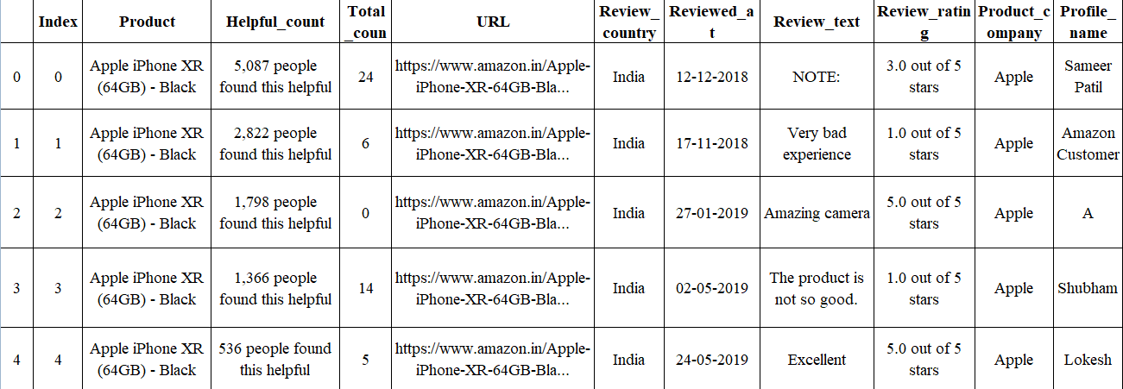
Data_Reviews

Slide 6
Preprocessing:
df.isna().sum()
index 0
product 0
helpful_count 0
total_comments 0
url 0
review_country 0
reviewed_at 0
review_text 3
review_rating 0
product_company 0
profile_name 0
review_title 2
dtype: int64

Slide 7
Make Predictions on the review texts:
Python
# Make predictions on the review texts
outputs = model(input_ids, attention_mask)
predictions = outputs.logits.argmax(dim=1)
Calculate the sentiment distribution.
Python
# Calculate the sentiment distribution
sentiment_counts = predictions.bincount()
sentiment_distribution = sentiment_counts / sentiment_counts.sum()

Slide 8
Plot the sentiment distribution graph
Python
# Plot the sentiment distribution graph
plt.figure(figsize=(10, 6))
plt.bar(['Positive', 'Negative'], sentiment_distribution)
plt.xlabel('Sentiment')
plt.ylabel('Proportion of Reviews')
plt.title('iPhone Amazon Reviews Sentiment Distribution')
plt.show()
plt.figure(figsize=(15,6))
for idx, col in enumerate(numeric):
plt.subplot(1, 3, idx+1)
sns.histplot(df[col], bins=15)
plt.title(col)

Slide 9
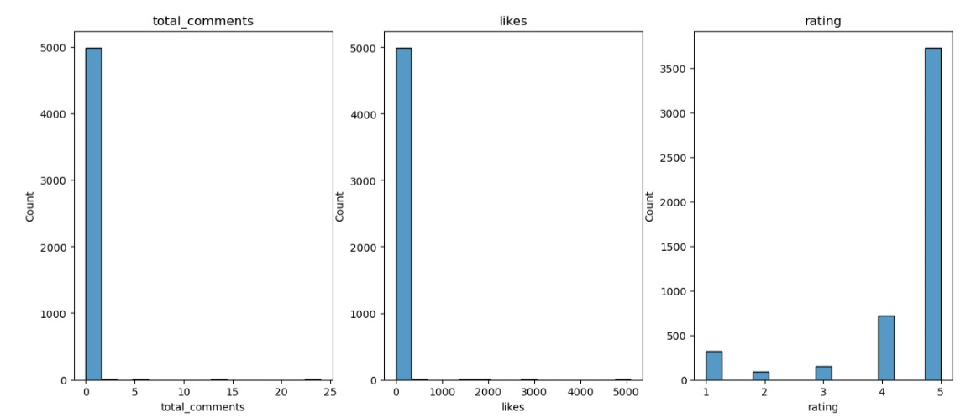

Slide 10
